Slide 1
48 - Beautiful Love
Words & Music by
Michael Carpenter
© 2002 Michael J. Carpenter

Slide 2
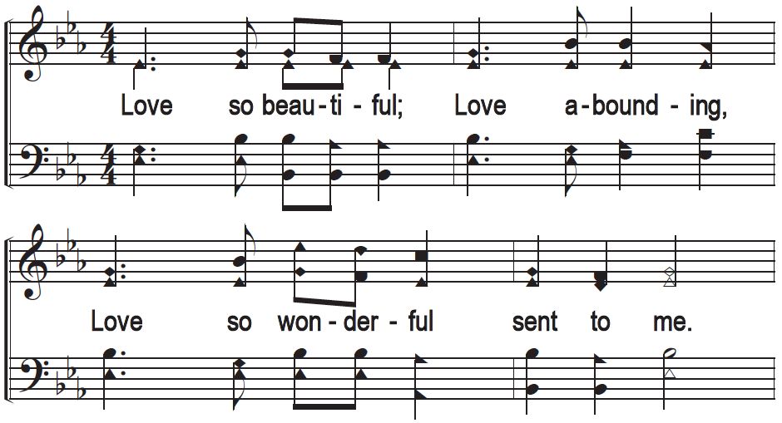
Beautiful Love - 1

Slide 3
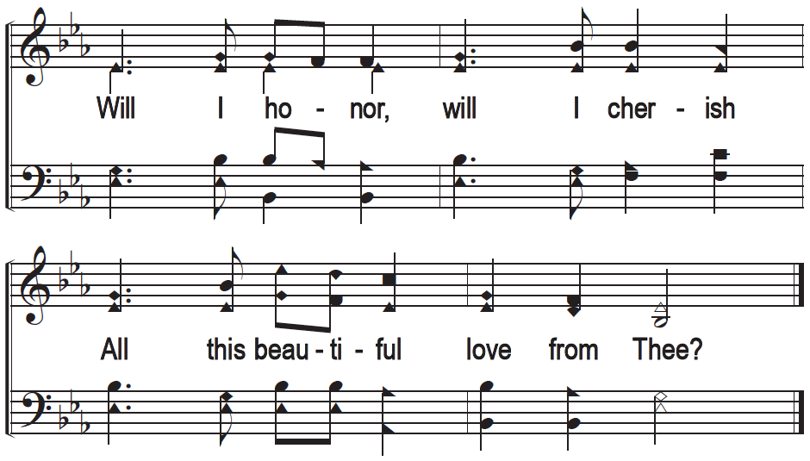
Beautiful Love - 1

Slide 4
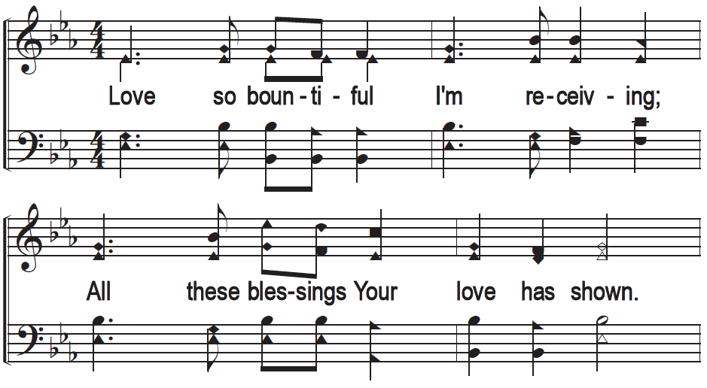
Beautiful Love - 2

Slide 5
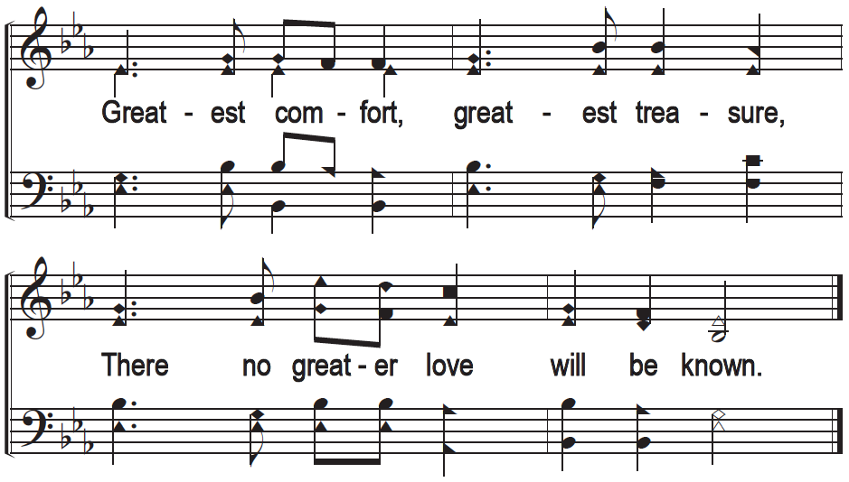
Beautiful Love - 2

Slide 6
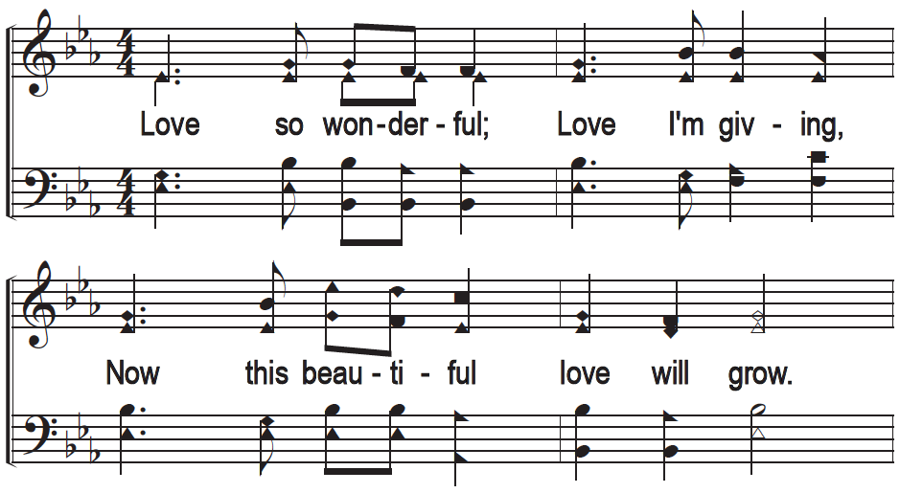
Beautiful Love - 3

Slide 7
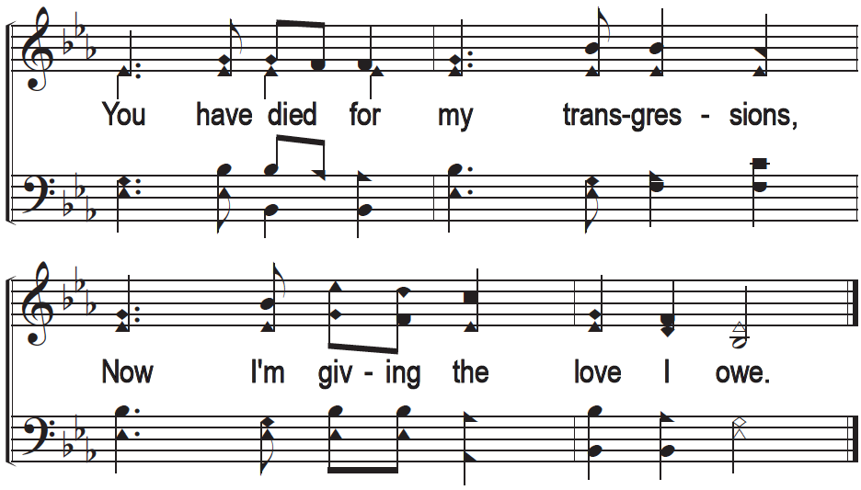
Beautiful Love - 3

