Slide 1
49 - Bow Down Before You
Words & Music by
Michael Carpenter
© 2002 Michael J. Carpenter

Slide 2
1 - Bow Down Before You

Slide 3
c - Bow Down Before You

Slide 4
2 - Bow Down Before You

Slide 5
c - Bow Down Before You

Slide 6
3 - Bow Down Before You

Slide 7
c - Bow Down Before You

Slide 8
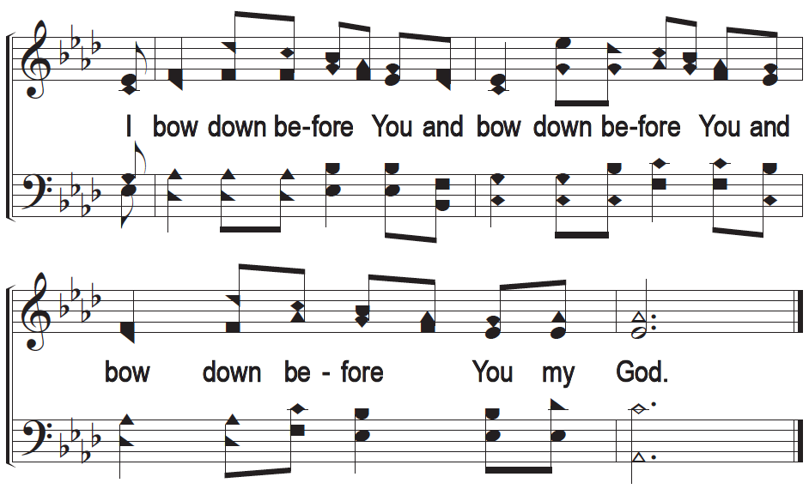
c - Bow Down Before You

