Slide 1
64 - Glory to God
Words & Music by
Michael Carpenter
© 2003 Michael J. Carpenter

Slide 2
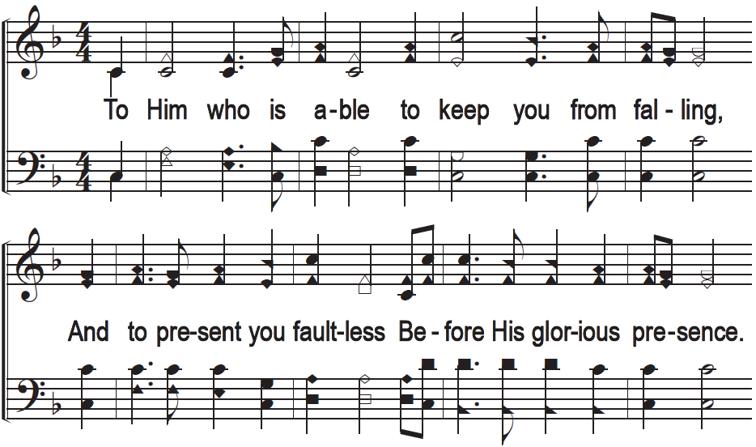
Glory to God

Slide 3
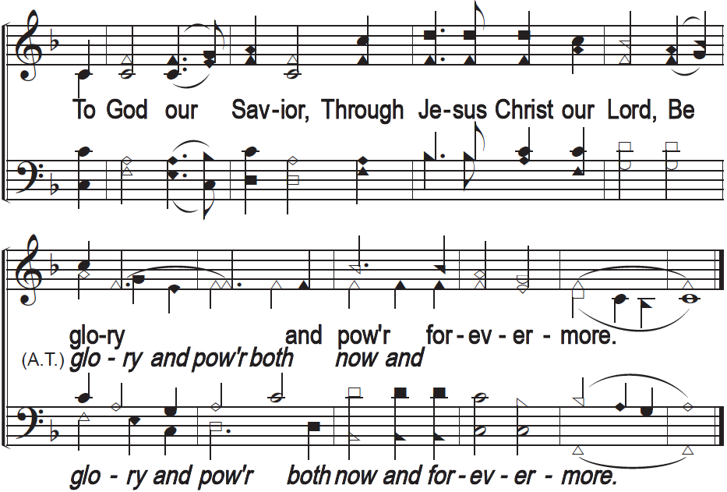
Glory to God

