Slide 1
He Shall Reign (revised)
Words & Music by
Michael Carpenter
© 2013 Michael J. Carpenter

Slide 2
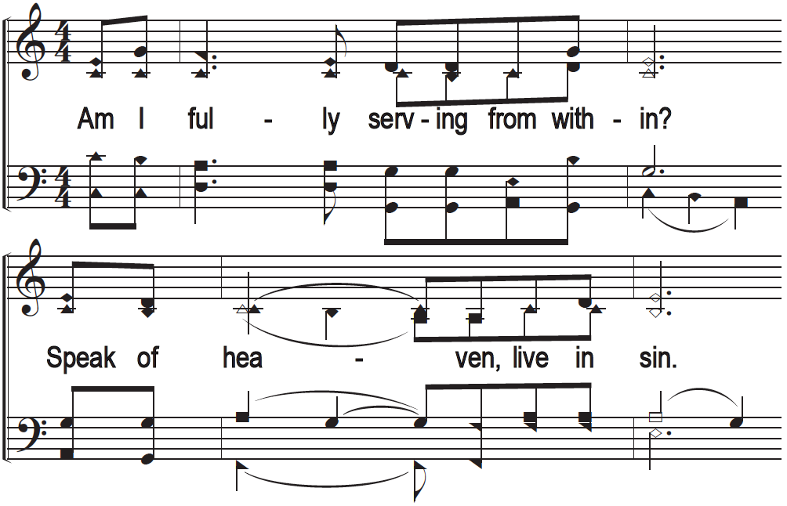
He Shall Reign!

Slide 3
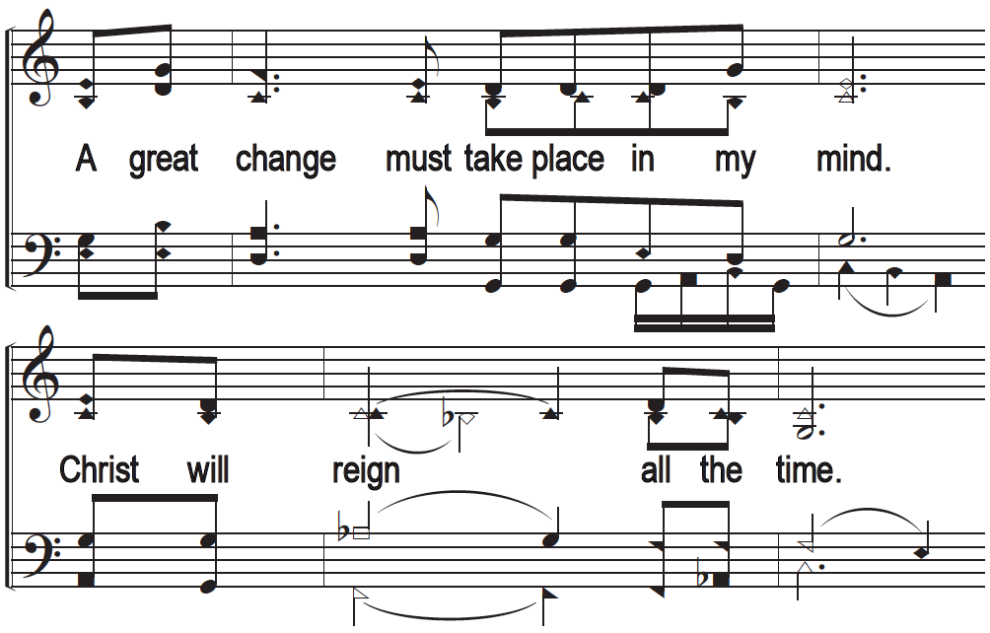
He Shall Reign!

Slide 4
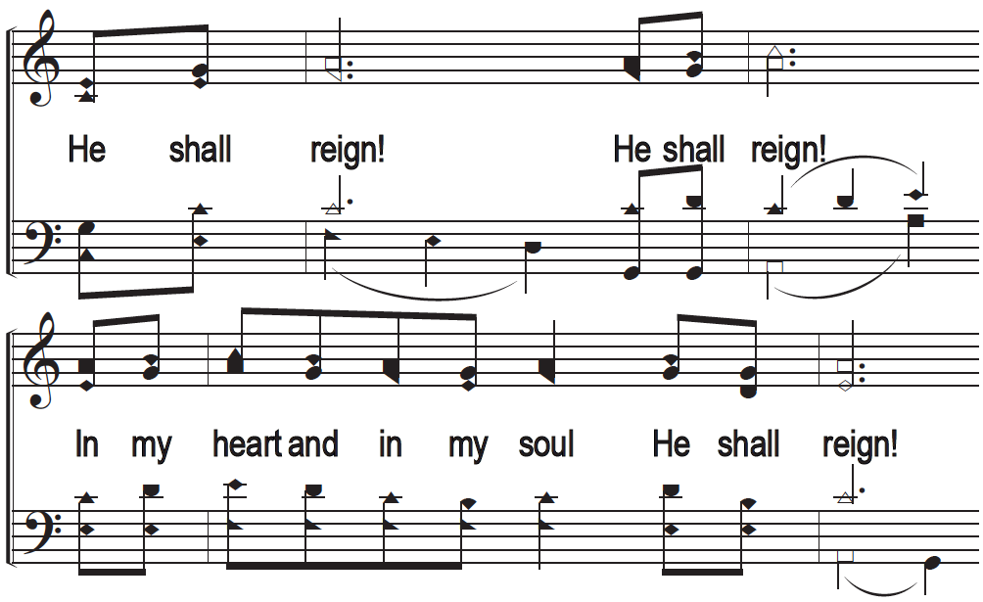
He Shall Reign!

Slide 5
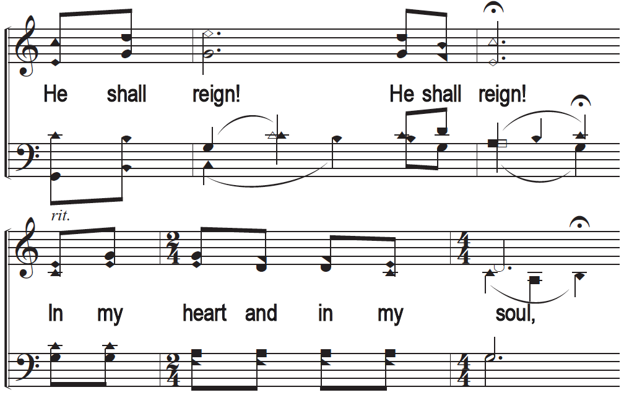
He Shall Reign!

Slide 6
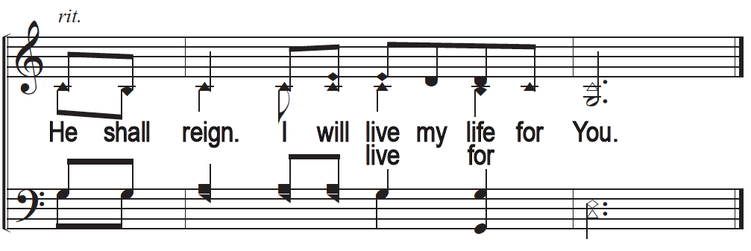
He Shall Reign!

