Slide 1
Love Unsurpassing
Music and lyrics by Michael Carpenter
© 2002 Michael J. Carpenter

Slide 2
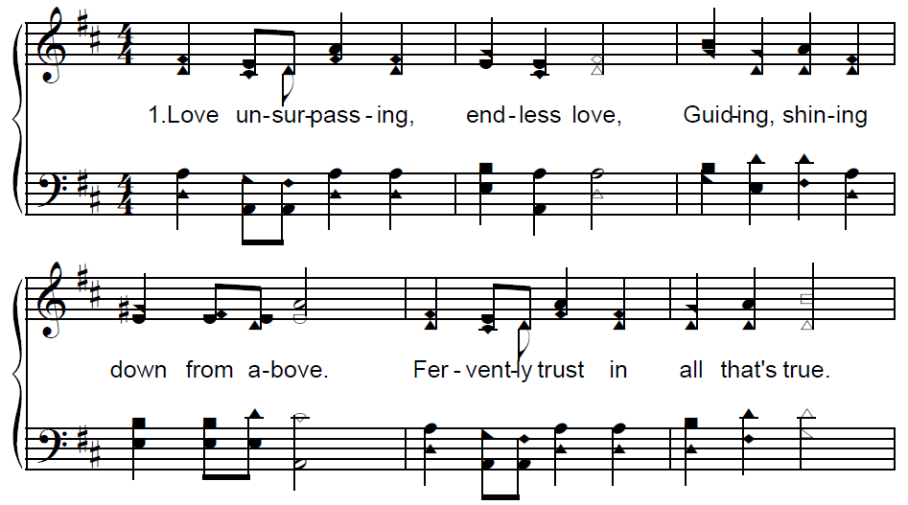
Love Unsurpassing

Slide 3
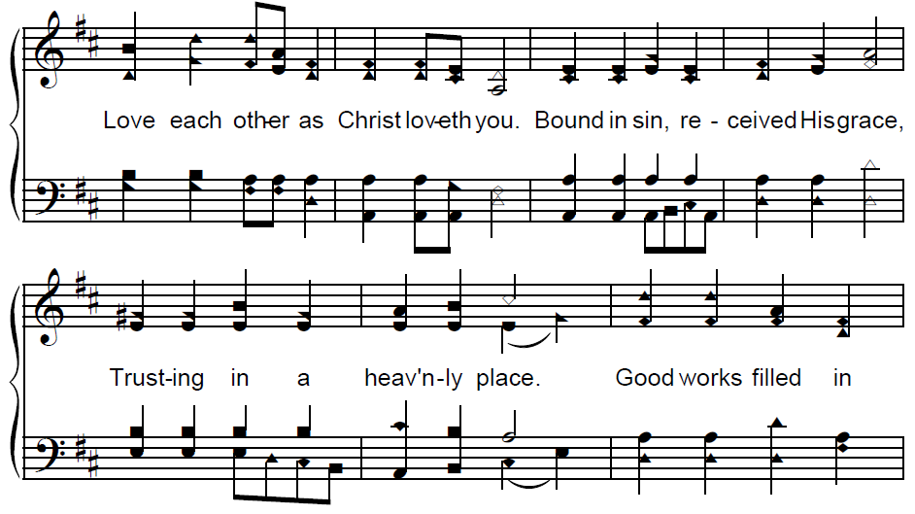
Love Unsurpassing

Slide 4
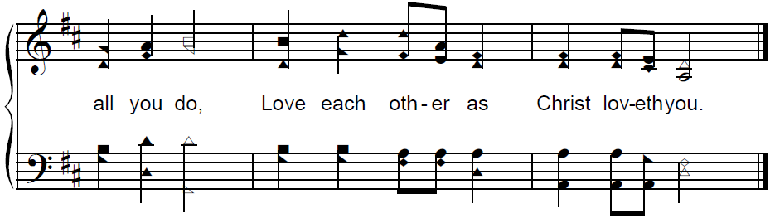
Love Unsurpassing

Slide 5
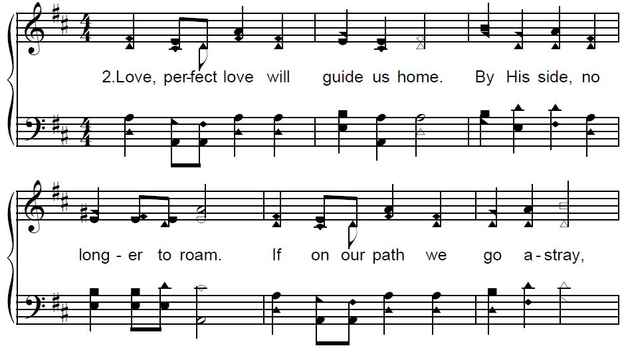
Love Unsurpassing

Slide 6
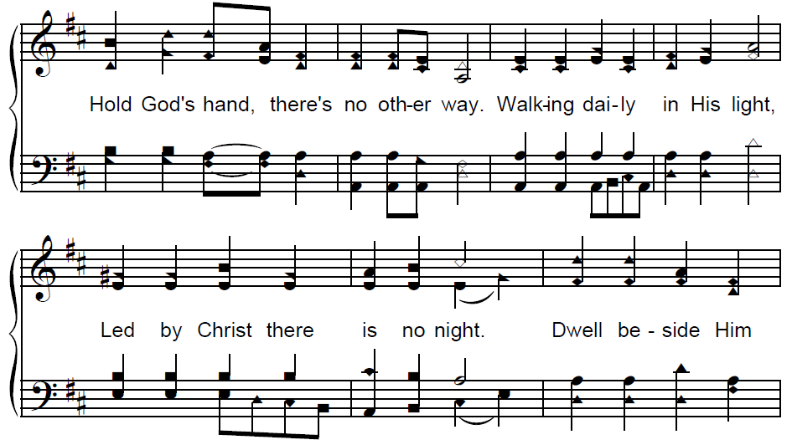
Love Unsurpassing

Slide 7
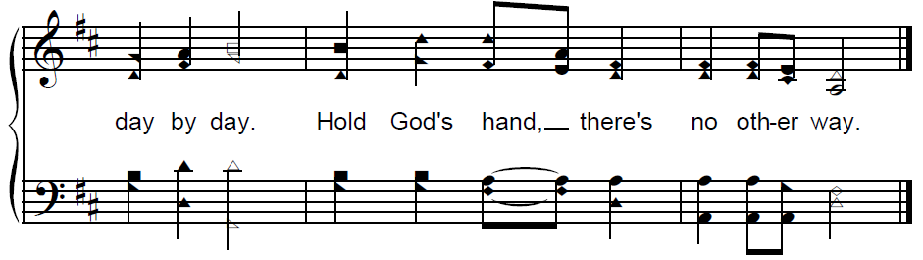
Love Unsurpassing

Slide 8
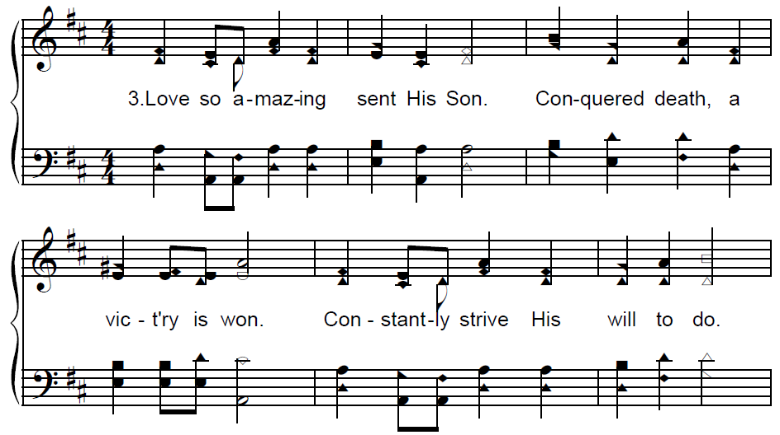
Love Unsurpassing

Slide 9
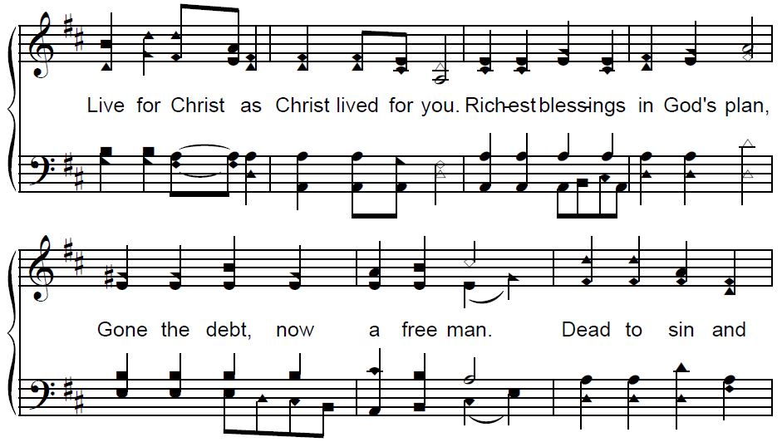
Love Unsurpassing

Slide 10
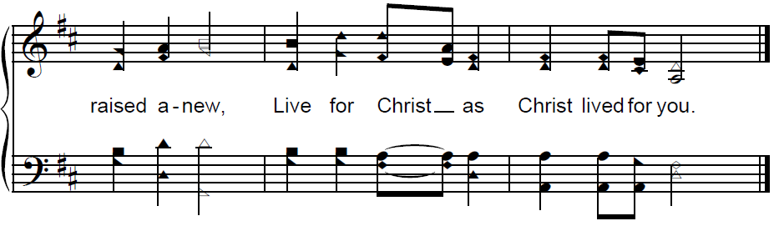
Love Unsurpassing
© 2002 Michael J. Carpenter

