Slide 1
Turn to Me
Music and lyrics by Michael Carpenter
© 2002 Michael J. Carpenter

Slide 2
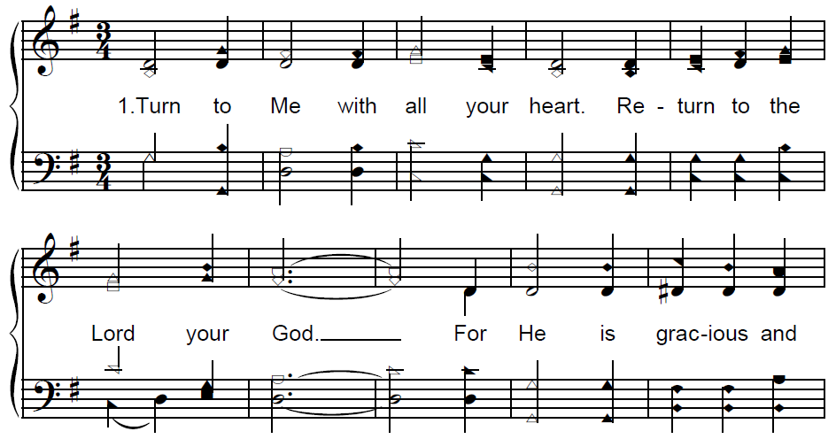
Turn to Me

Slide 3
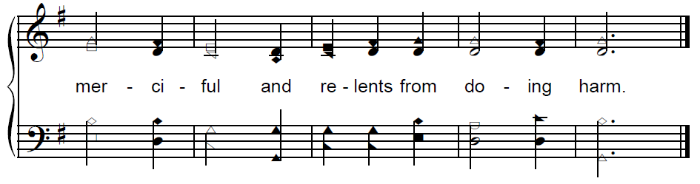
Turn to Me

Slide 4
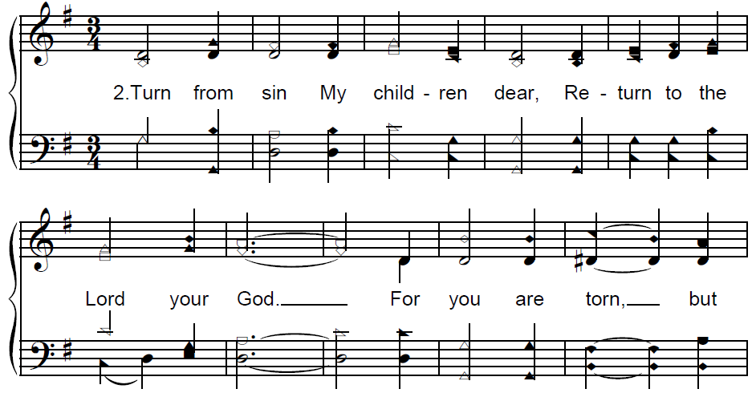
Turn to Me

Slide 5
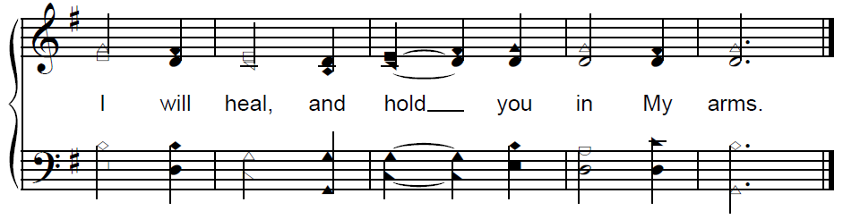
Turn to Me

Slide 6
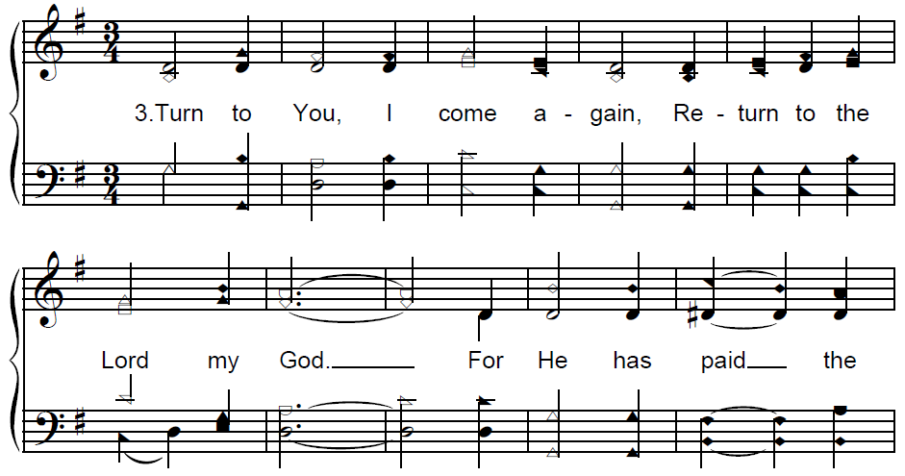
Turn to Me

Slide 7
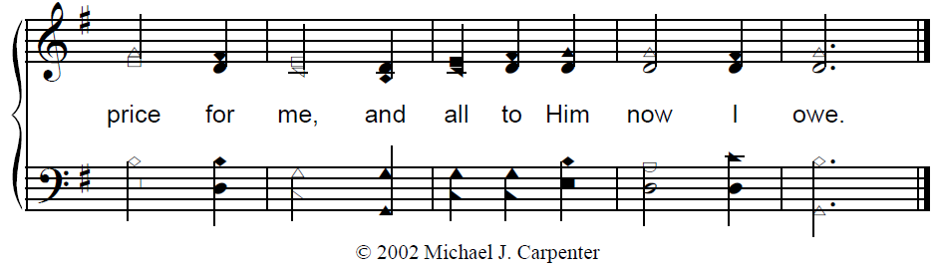
Turn to Me

