Slide 1
56 - Gazing At The Mountain
Lyrics by Ruth Grubb
Music by Michael Carpenter
© 2004 Michael J. Carpenter

Slide 2
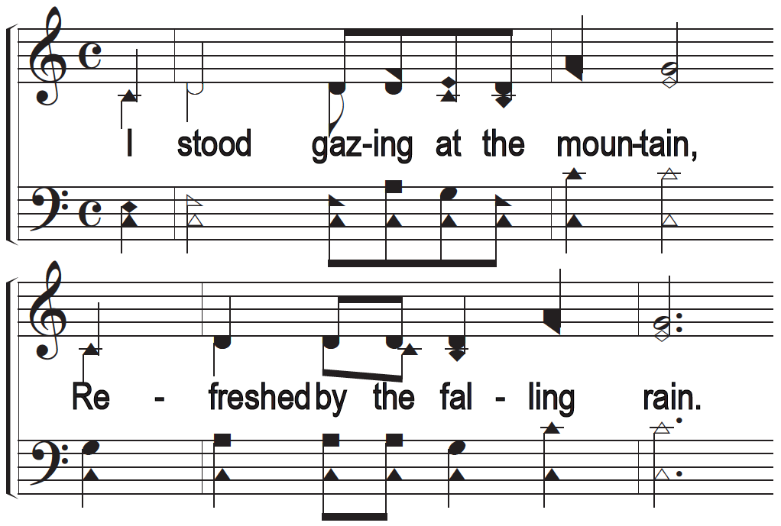
Gazing At The Mountain

Slide 3
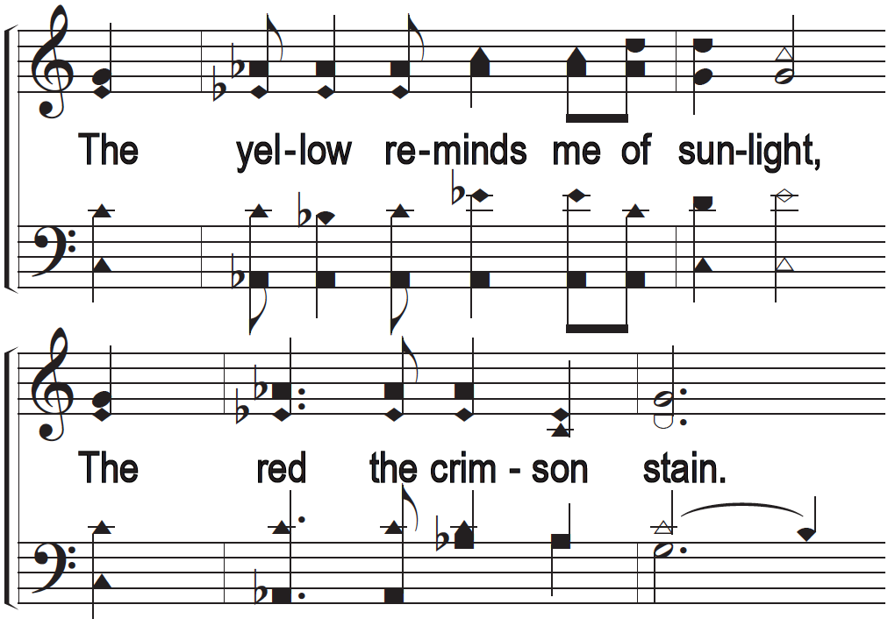
Gazing At The Mountain

Slide 4
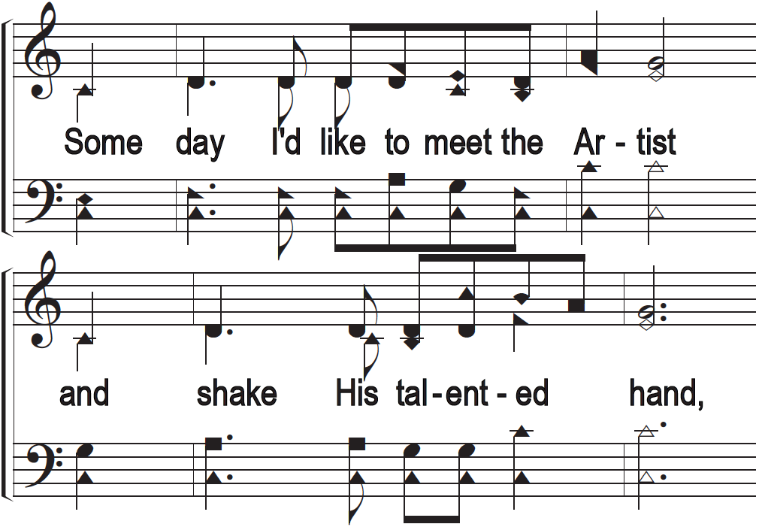
Gazing At The Mountain

Slide 5
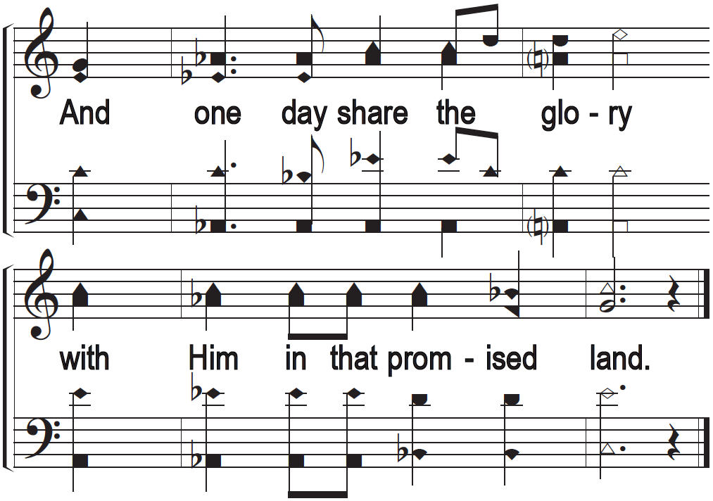
Gazing At The Mountain

