Slide 1
77 - Broken and Blessed
Words & Music by Mike Yost
Arranged by Michael Carpenter
© 2016 Michael D. Yost

Slide 2
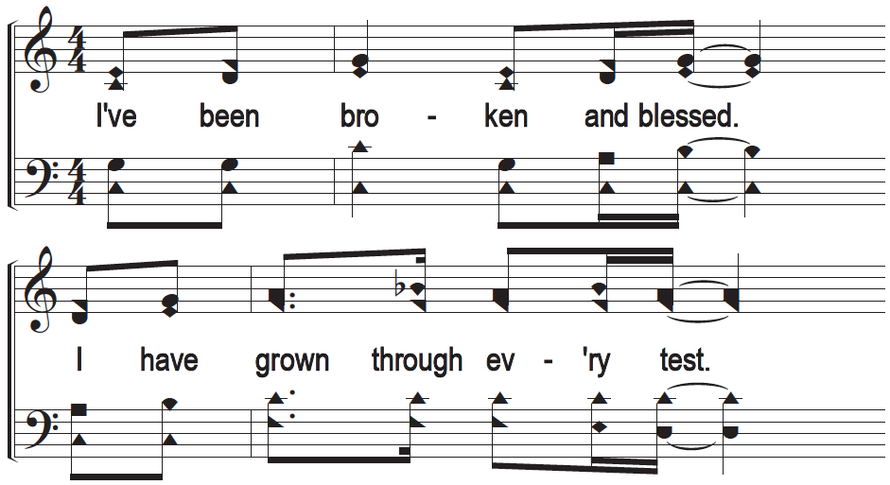
c - Broken and Blessed

Slide 3
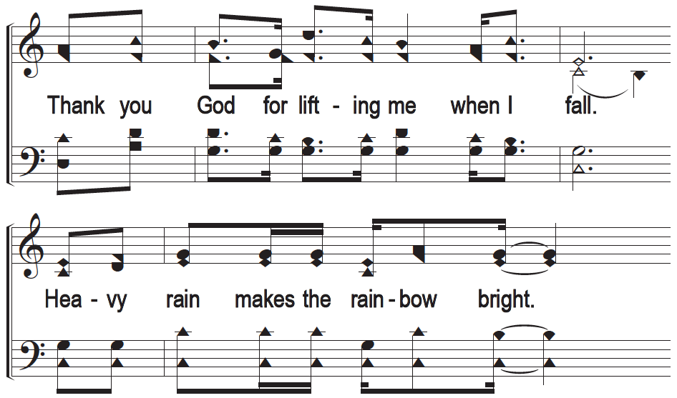
c - Broken and Blessed

Slide 4
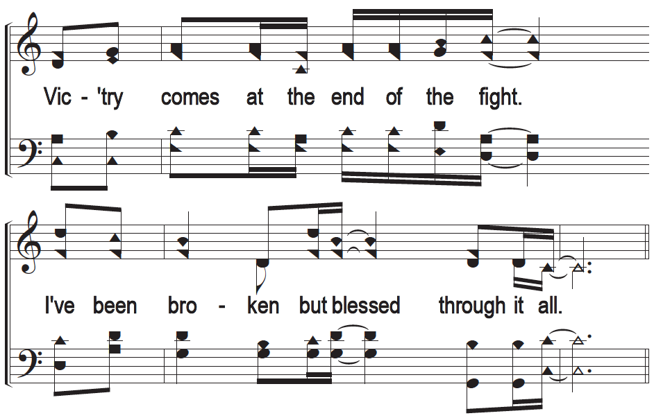
c - Broken and Blessed

Slide 5
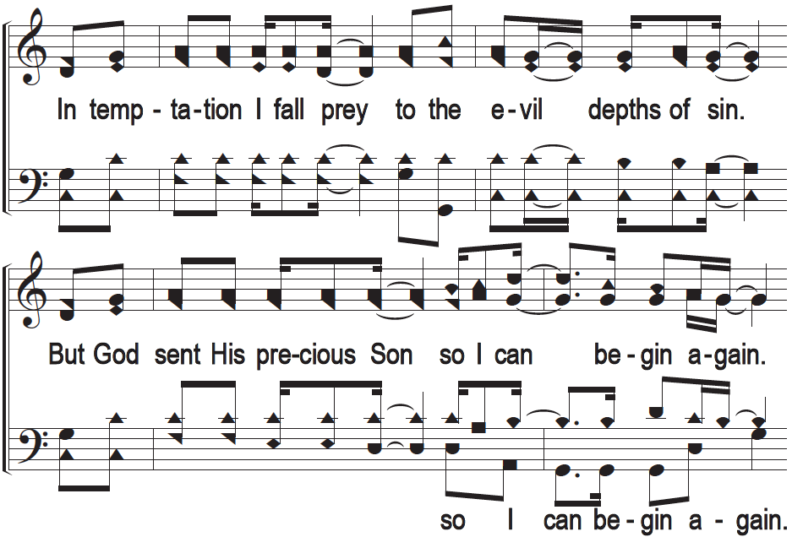
1 - Broken and Blessed

Slide 6
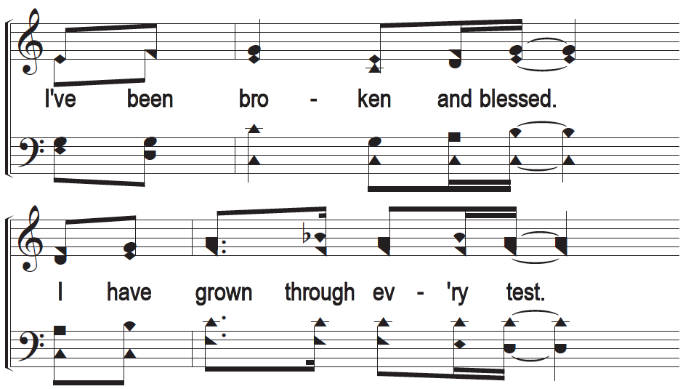
c - Broken and Blessed

Slide 7
c - Broken and Blessed

Slide 8
c - Broken and Blessed

Slide 9
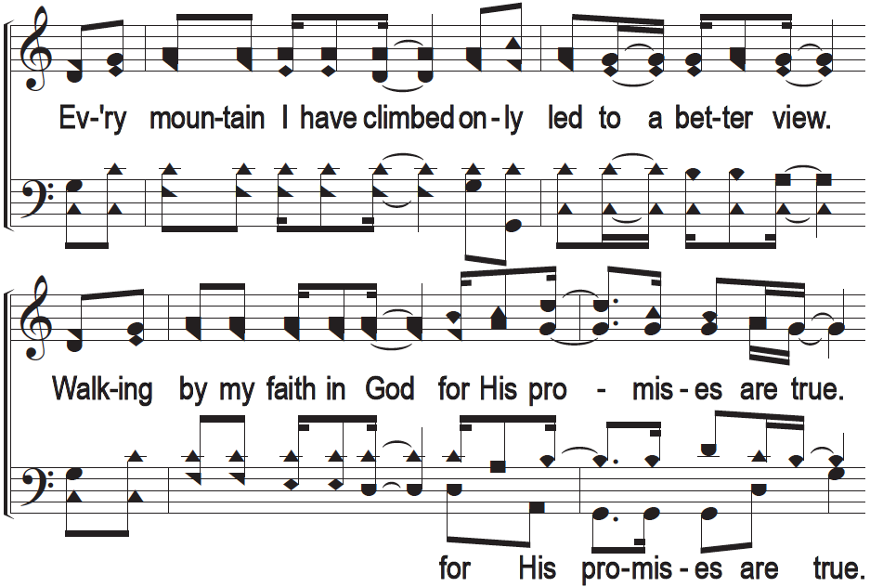
2 - Broken and Blessed

Slide 10
c - Broken and Blessed

Slide 11
c - Broken and Blessed

Slide 12
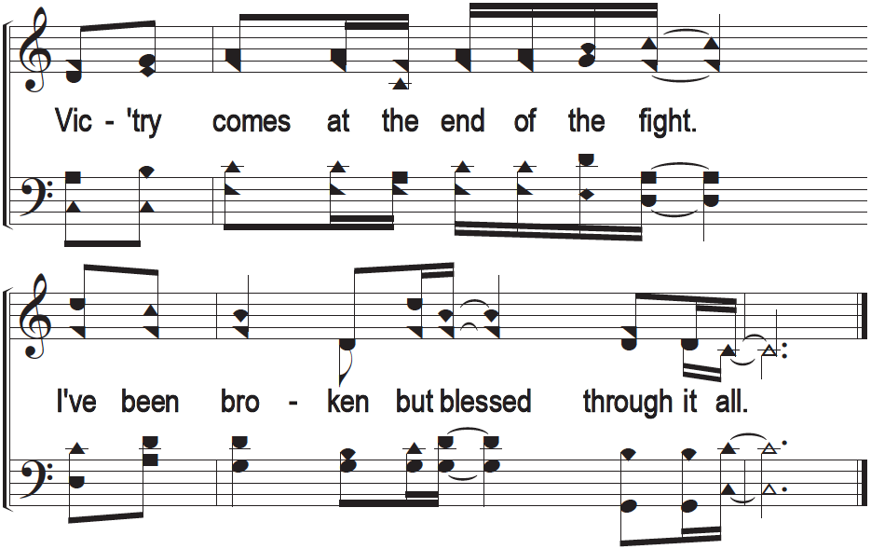
c - Broken and Blessed

