Slide 1
81 - Comfort Me, O Gentle Savior
Words & Music by
Michael Carpenter
© 2003 Michael J. Carpenter

Slide 2
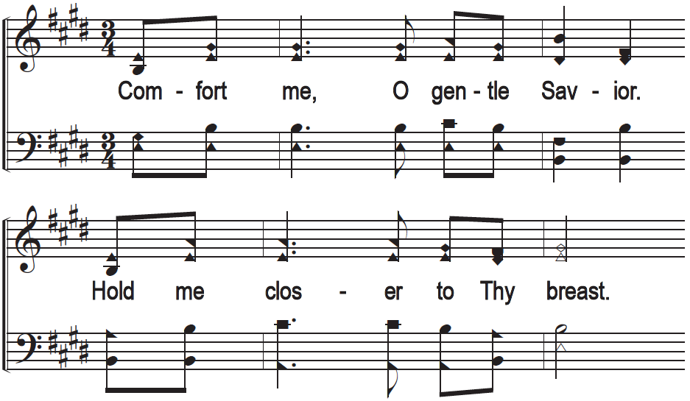
1 - Comfort Me, O Gentle Savior

Slide 3
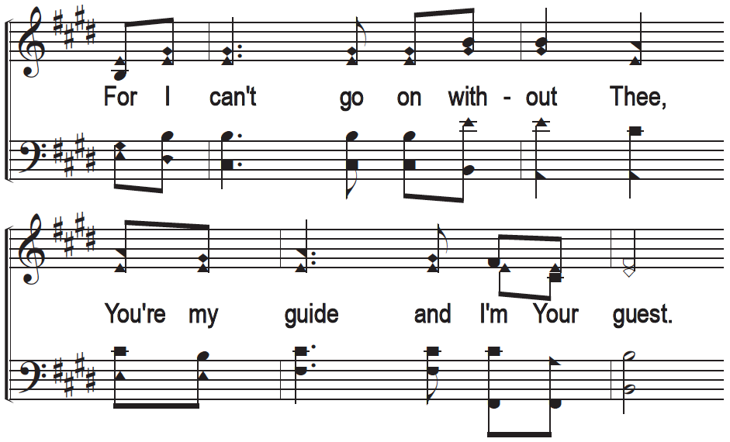
1 - Comfort Me, O Gentle Savior

Slide 4
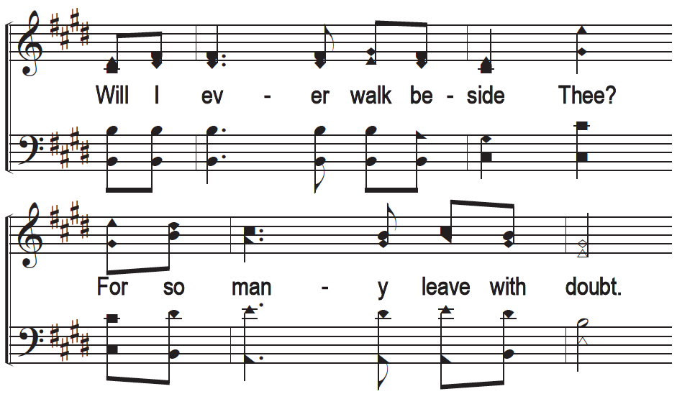
1 - Comfort Me, O Gentle Savior

Slide 5
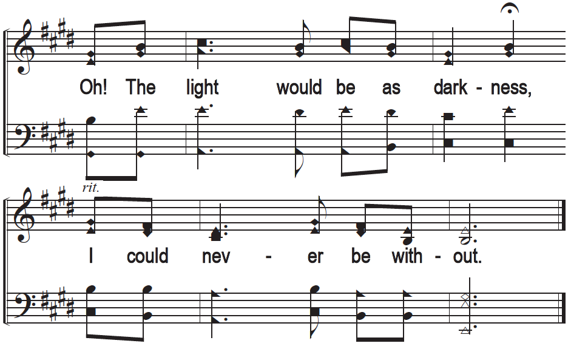
1 - Comfort Me, O Gentle Savior

Slide 6
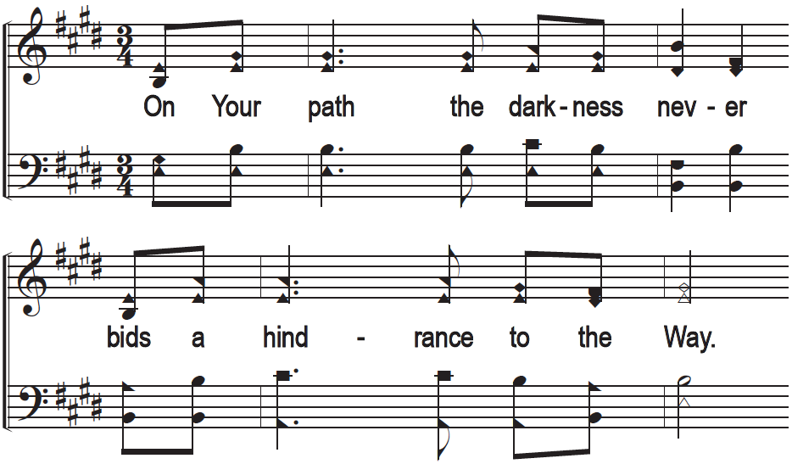
2 - Comfort Me, O Gentle Savior

Slide 7
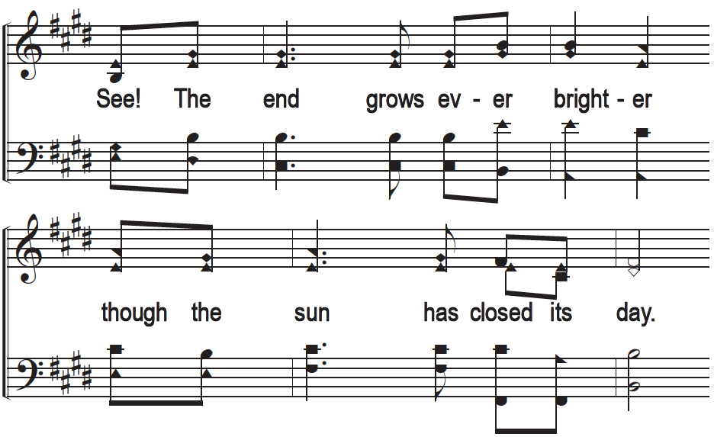
2 - Comfort Me, O Gentle Savior

Slide 8
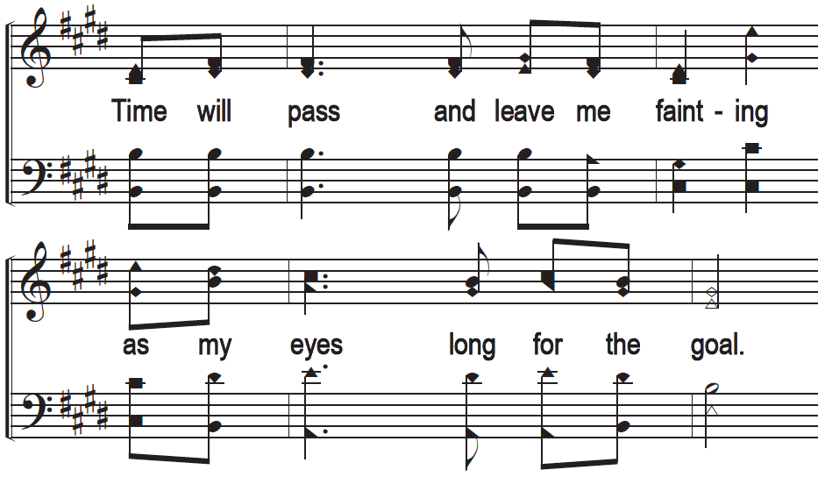
2 - Comfort Me, O Gentle Savior

Slide 9
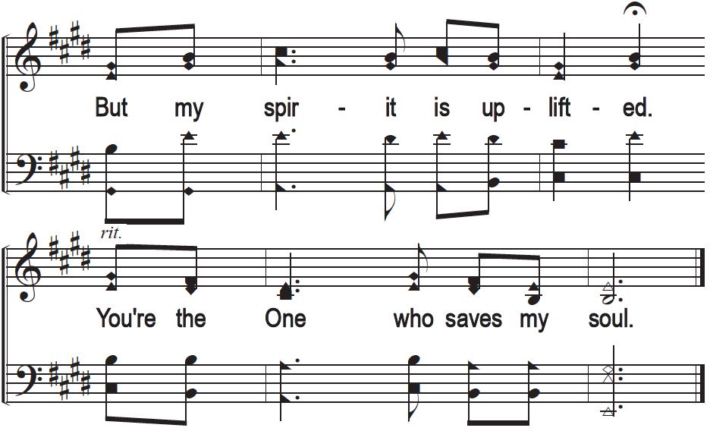
2 - Comfort Me, O Gentle Savior

